Slide 1
Data Link MAC Layer

Slide 2
Session Objectives
Multiple Access Protocols
Random Access Protocols
    Pure ALOHA and Slotted ALOHA
    CSMA/CD
    CSMA/CA
Controlled Access Protocols
    Reservation
    Polling
    Token Passing
Channelization Protocols
    FDMA
    TDMA
    CDMA
Notes:
1.#

Slide 3
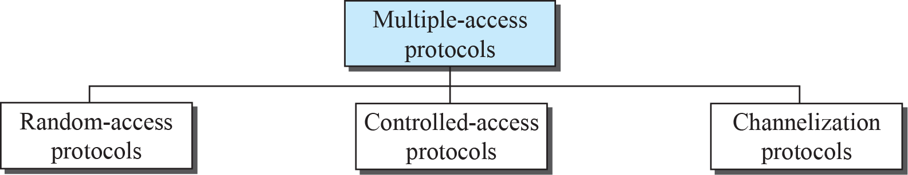
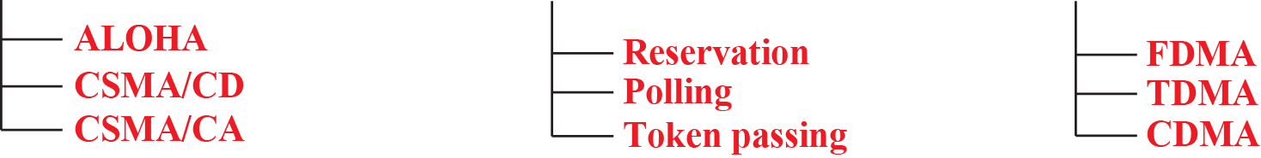
Multiple Access Protocols
Many protocols have been devised to handle access to a shared link. These are called MAC protocols.
Categories: Random-access, controlled-access and channelization protocols
Notes:
1.#

Slide 4
    RANDOM ACCESS
In random-access or contention no station is superior to another station and none is assigned control over another.
At each instance, a station that has data to send uses a procedure defined by the protocol to make a decision on whether or not to send.
This decision depends on the state of the medium (idle or busy).
Examples: PURE ALOHA , SLOTTED ALOHA, CSMA/CD and CSMA/CA
Notes:
12.#

Slide 5
    ALOHA Protocol
ALOHA, the earliest random access method, was developed at the University of Hawaii in early 1970.
It was designed for a radio (wireless) LAN, but it can be used on any shared medium.
It is obvious that there are potential collisions in this arrangement.
The medium is shared between the stations.
When a station sends data, another station may attempt to do so at the same time. The data from the two stations collide and become garbled.
Notes:
12.#

Slide 6
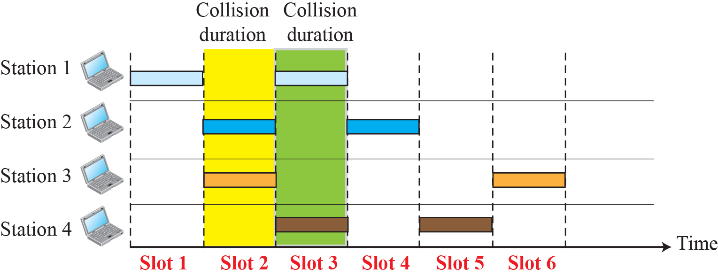
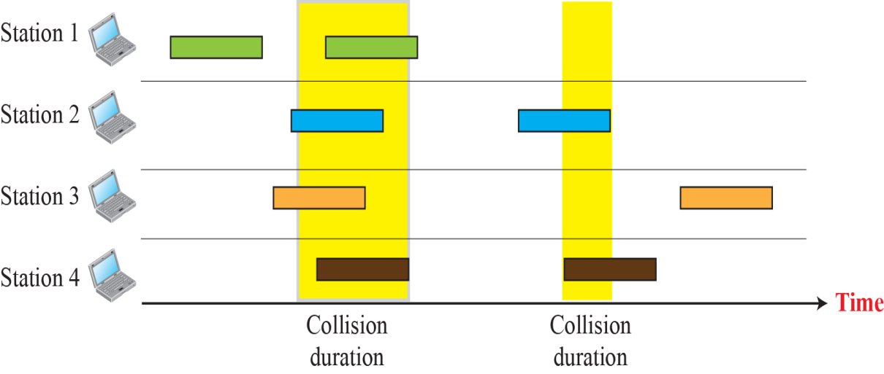
    Pure ALOHA and Slotted ALOHA Protocol
Pure ALOHA network
Slotted ALOHA network
Notes:
12.#

Slide 7
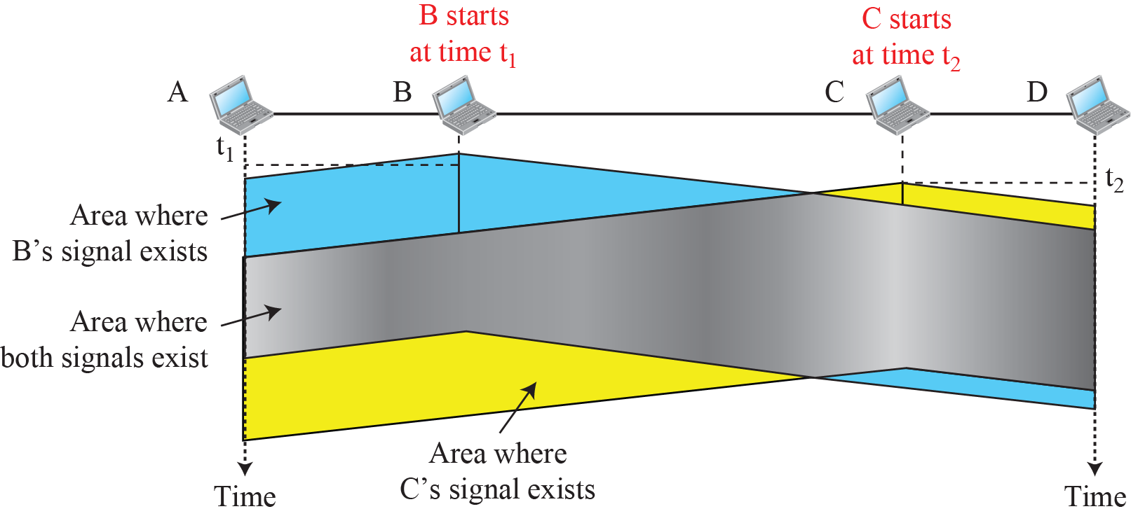
    Carrier Sense Multiple Access (CSMA) Protocol
To minimize the chance of collision and, therefore, increase the performance, the CSMA method was developed.
Carrier sense multiple access (CSMA) requires that each station first listen (sense) to the medium before sending.
In other words, CSMA is based on the principle “sense before transmit” or “listen before talk.”
Notes:
12.#

Slide 8
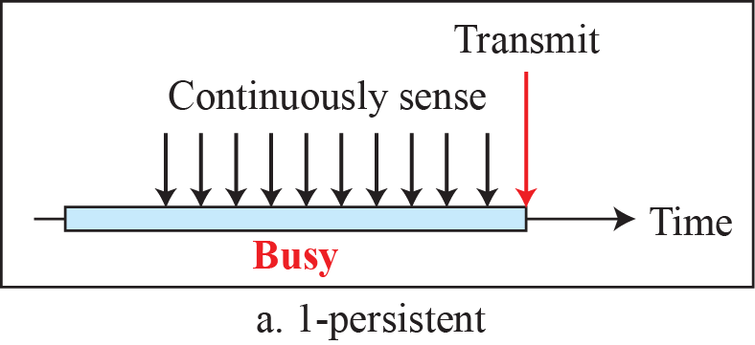
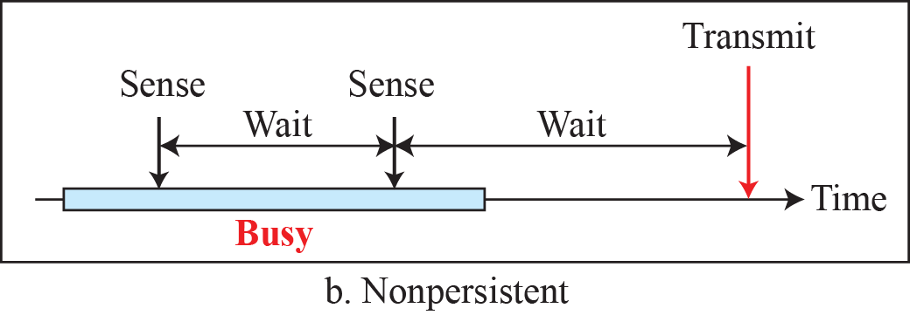
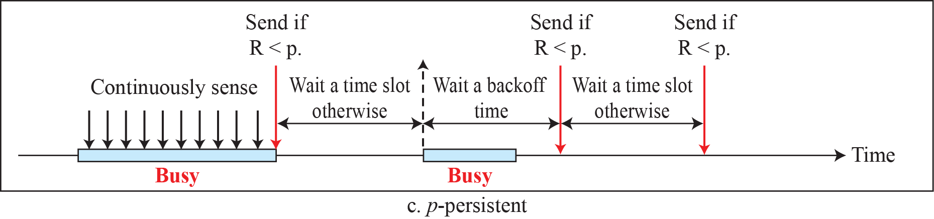
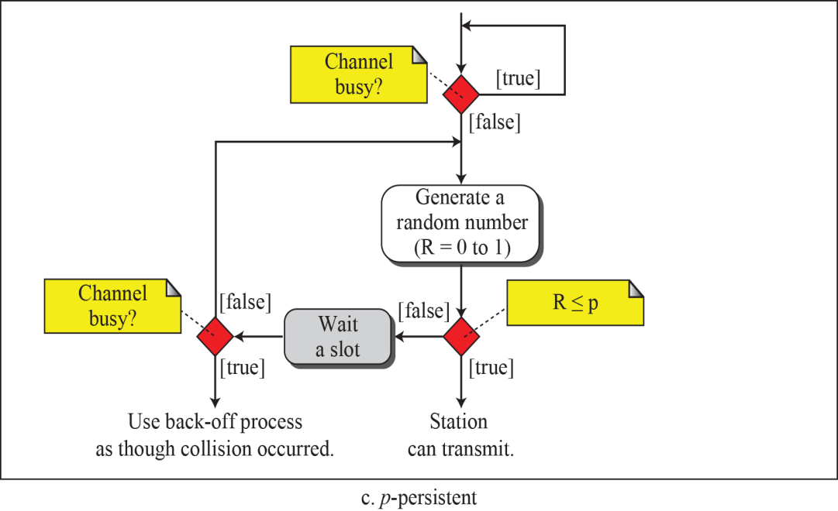
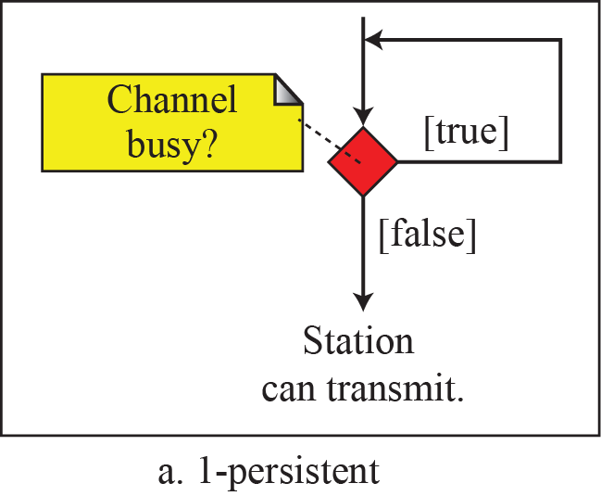
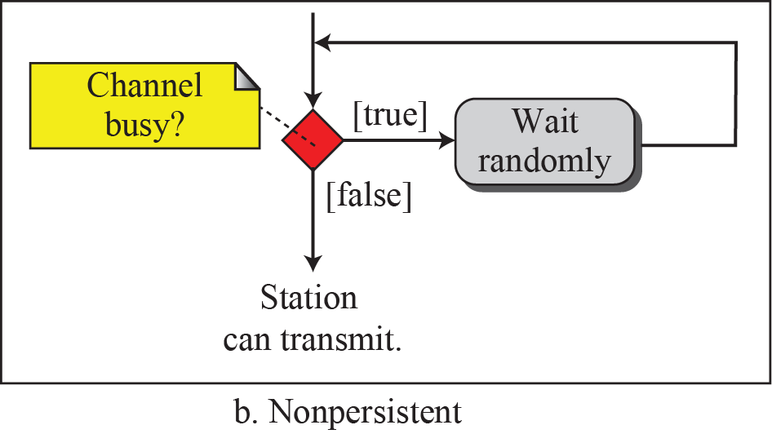
    CSMA persistence methods
Notes:
12.#

Slide 9
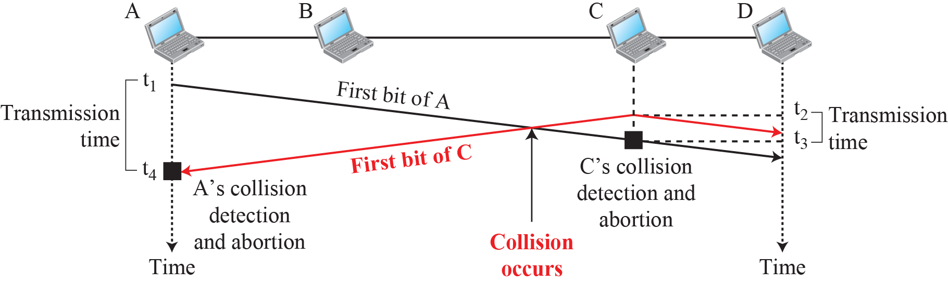
    CSMA/CD Protocol
The CSMA method does not specify the procedure following a collision. Carrier sense multiple access with collision detection (CSMA/CD) augments the algorithm to handle the collision.
In this method, a station monitors the medium after it sends a frame to see if the transmission was successful. If so, the station is finished. If, however, there is a collision, the frame is sent again.
Notes:
12.#

Slide 10
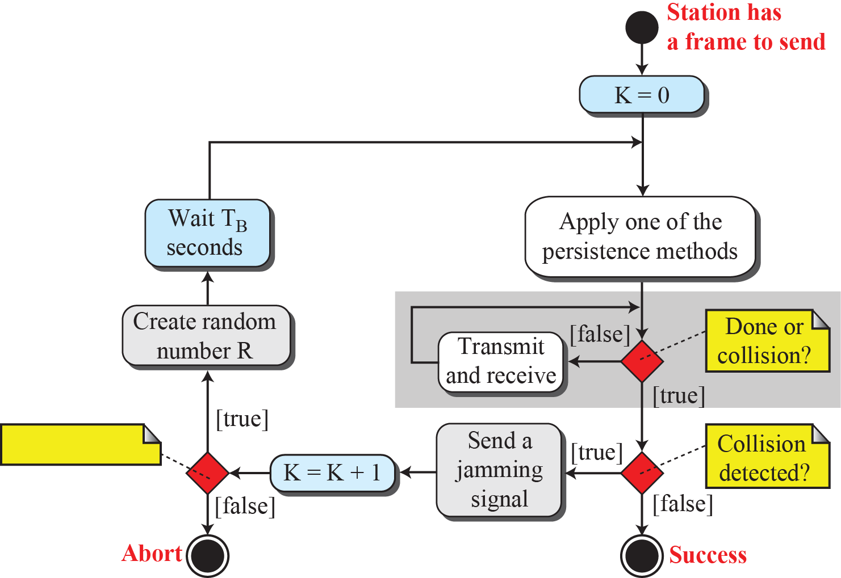
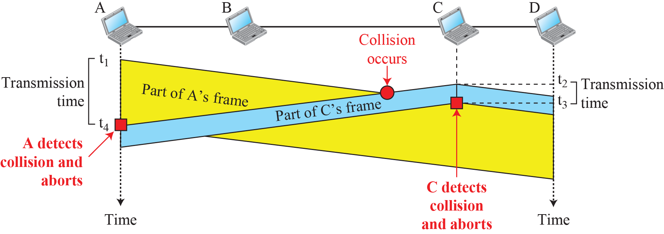
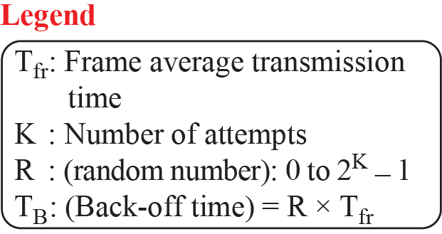
    CSMA/CD Collision Abortion
Notes:
12.#

Slide 11
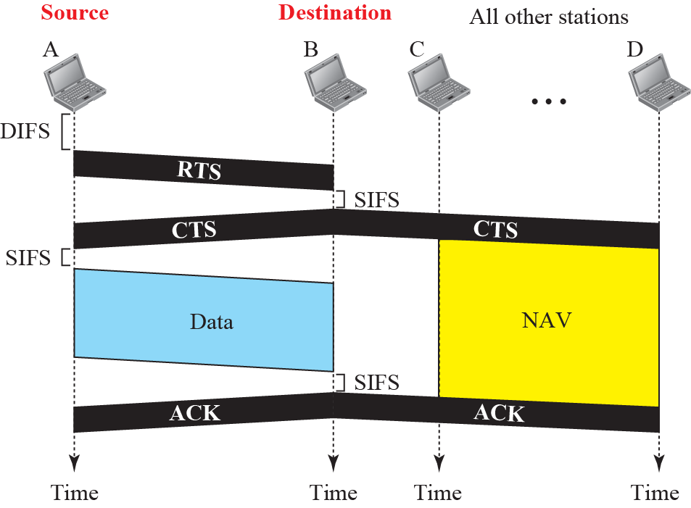
    CSMA/CA Protocol
Carrier sense multiple access with collision avoidance (CSMA/CA) was invented for wireless networks.
Collisions are avoided through the use of CSMA/CA’s three strategies: the inter frame space, the contention window, and acknowledgments.
Notes:
12.#
network allocation vector (NAV) NAV represents the number of microseconds the sending STA intends to hold the medium busy

Slide 12
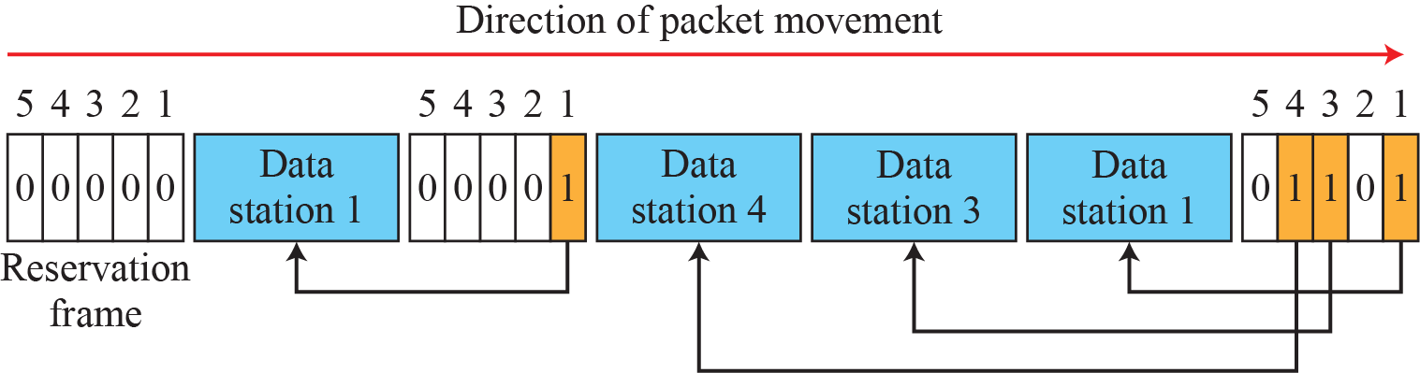
    Controlled Access Protocol
Reservation
In the reservation method, a station needs to make a reservation before sending data.
Time is divided into intervals.
In each interval, a reservation frame precedes the data frames sent in that interval.
Notes:
12.#

Slide 13


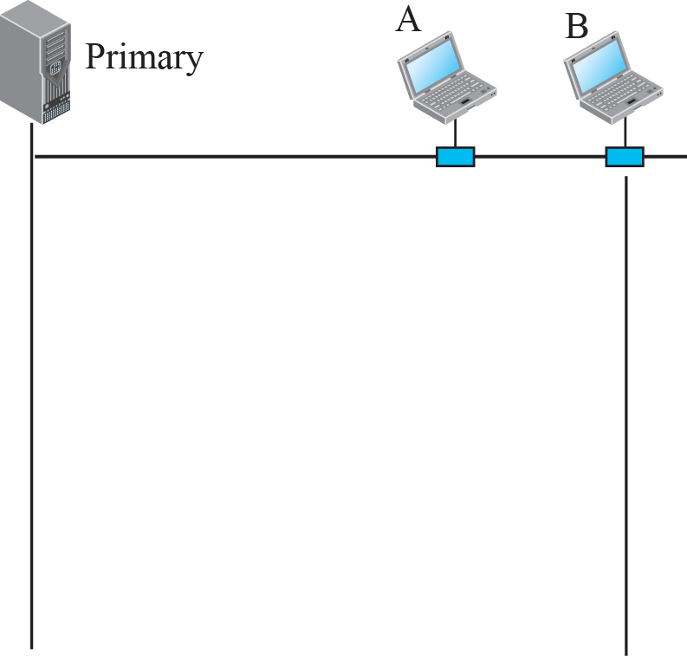
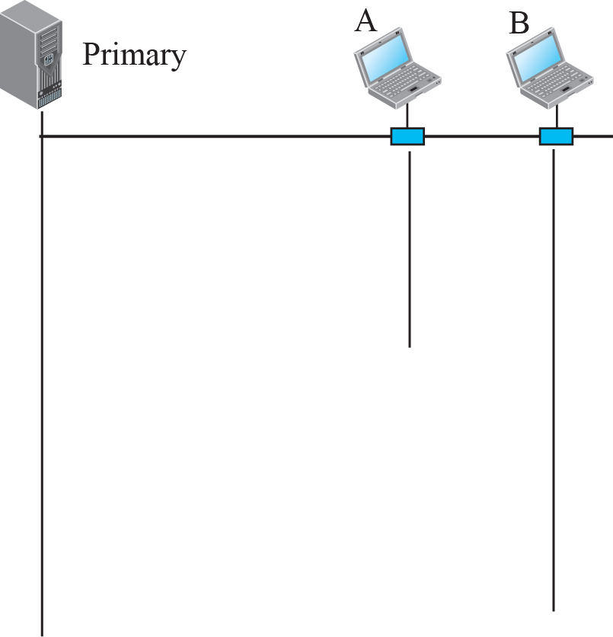





    Controlled Access Protocol
Polling
Polling works with topologies in which one device is designated as a primary station and the other devices are secondary stations.
All data exchanges must be made through the primary device even when the ultimate destination is a secondary device.
The primary device controls the link; the secondary devices follow its instructions.
It is up to the primary device to determine which device is allowed to use the channel at a given time.
Notes:
12.#
The negative-acknowledgement (NAK or NACK) signal is sent to reject a previously received message or to indicate some kind of error.

Slide 14
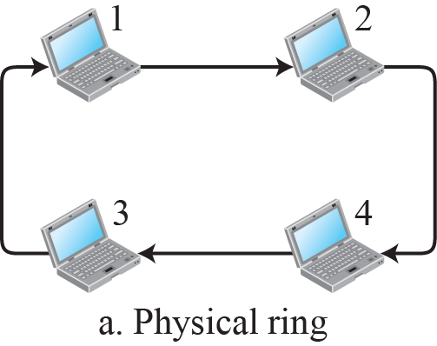
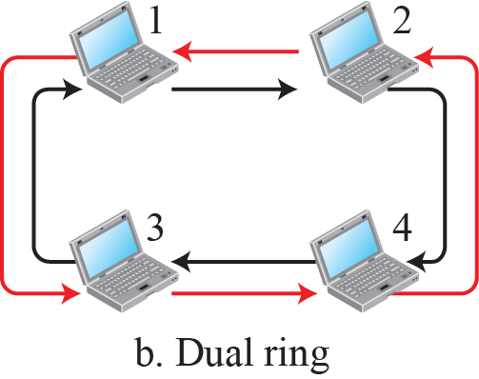
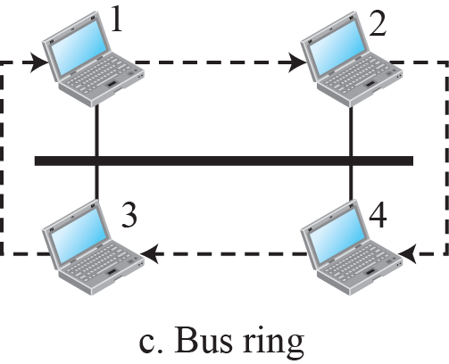
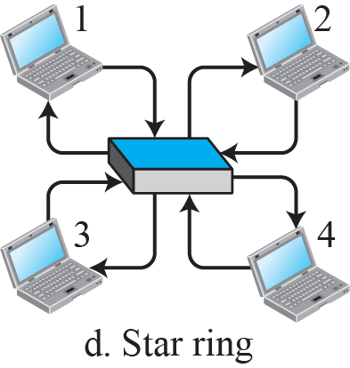
    Controlled Access Protocol
Token Passing
In the token-passing method, the stations in a network are organized in a logical ring. In other words, for each station, there is a predecessor and a successor.
The predecessor is the station which is logically before the station in the ring; the successor is the station which is after the station in the ring.
Notes:
12.#

Slide 15
    Channelization Protocol
Channelization (or channel partition, as it is sometimes called) is a multiple-access method in which the available bandwidth of a link is shared in time, frequency, or through code, among different stations.
Example: FDMA, TDMA, and CDMA.
FDMA:
In frequency-division multiple access (FDMA), the available bandwidth is divided into frequency bands.
Each station is allocated a band to send its data.
Each band is reserved for a specific station, and it belongs to the station all the time.
Each station also uses a band pass filter to confine the transmitter frequencies.
Notes:
12.#

Slide 16
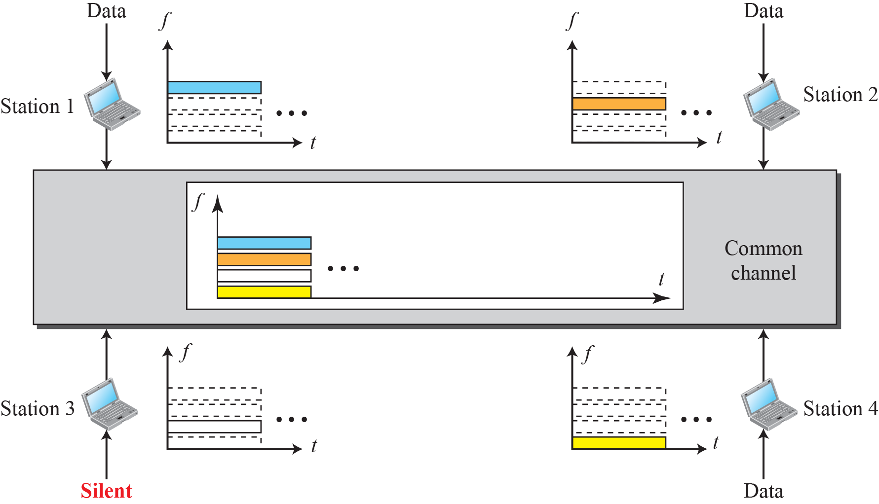
    FDMA Protocol

Slide 17
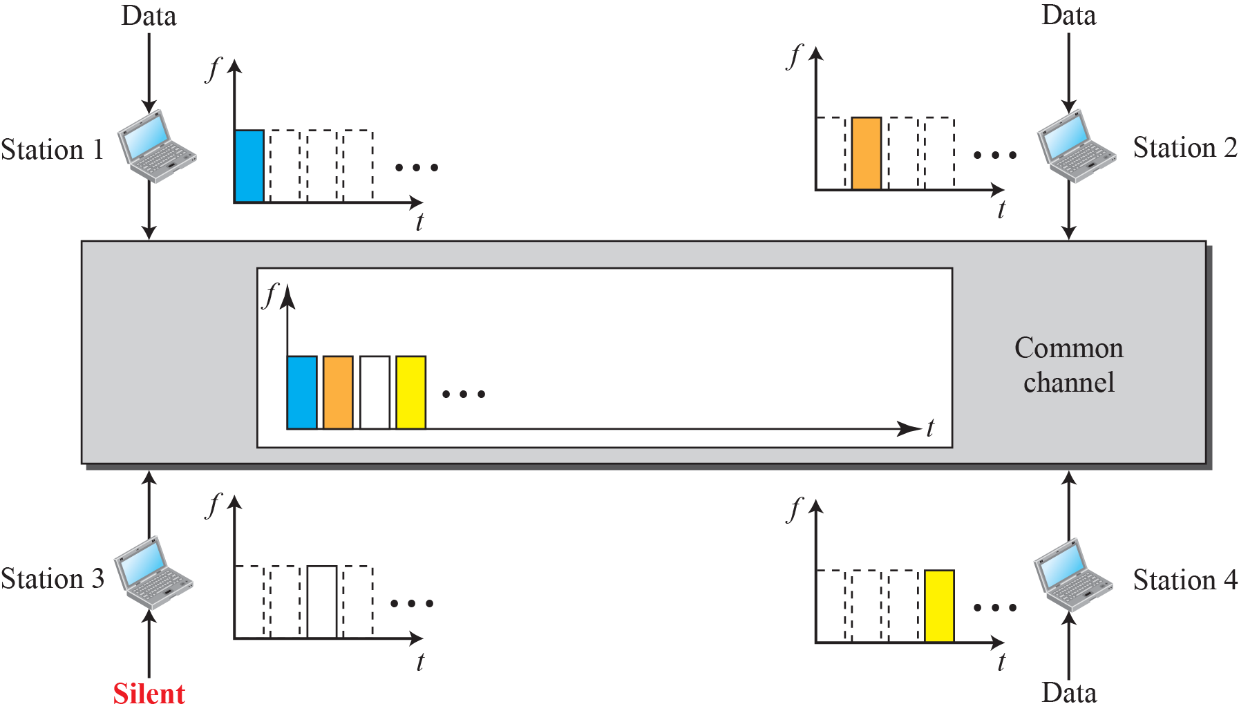
    TDMA Protocol
TDMA:
In time-division multiple access (TDMA), the stations share the bandwidth of the channel in time.
Each station is allocated a time slot during which it can send data. Each station transmits its data in its assigned time slot.
Notes:
12.#

Slide 18
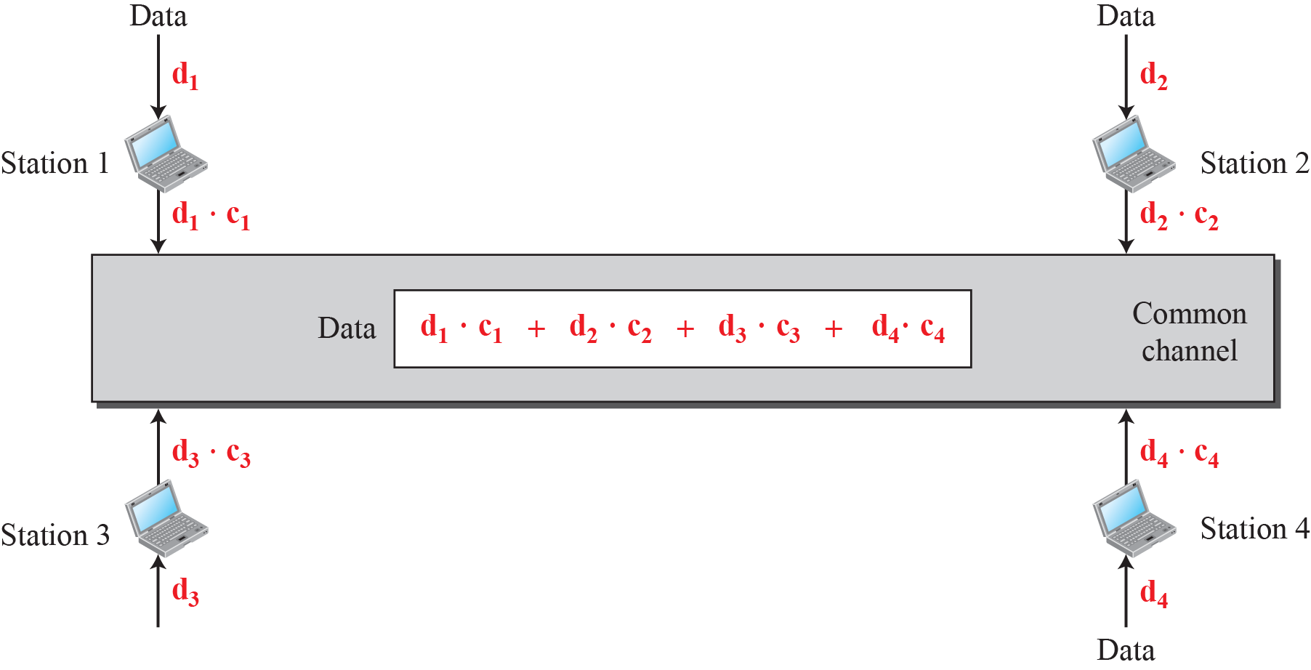
    CDMA Protocol
CDMA:
CDMA differs from FDMA in that only one channel occupies the entire bandwidth of the link.
It differs from TDMA in that all stations can send data simultaneously; there is no timesharing.
Notes:
12.#

Slide 19
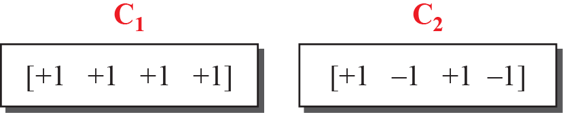
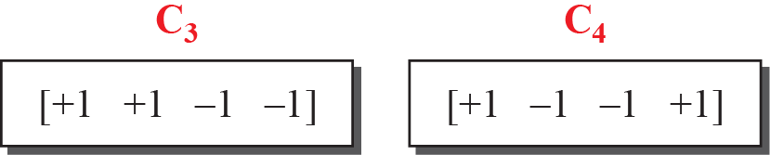
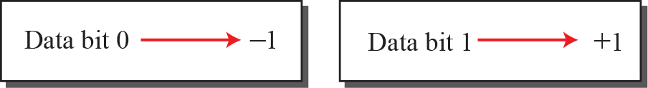
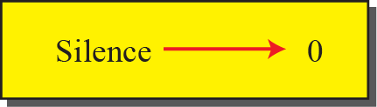
    Chipping Sequence and Data Representation in CDMA
Notes:
12.#

Slide 20
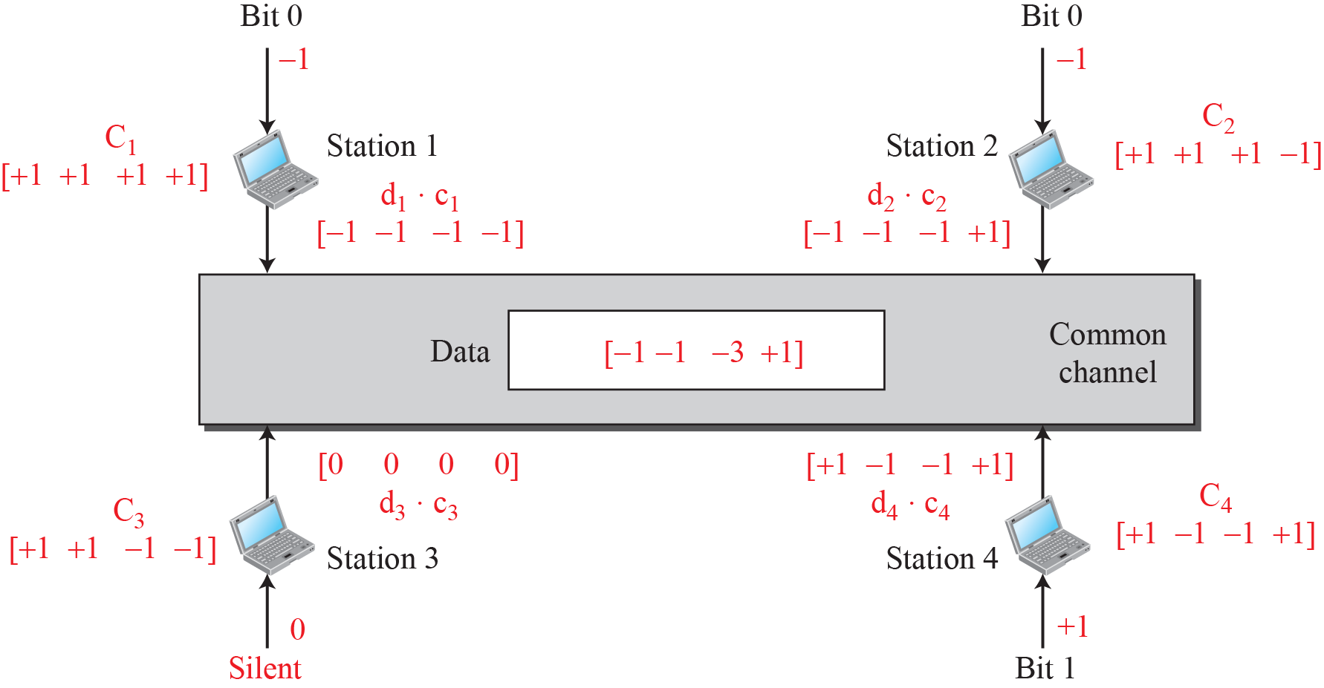
    Channel Sharing in CDMA
Notes:
12.#

Slide 21
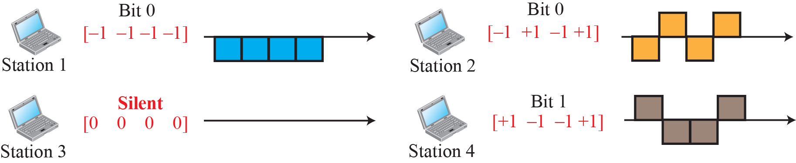
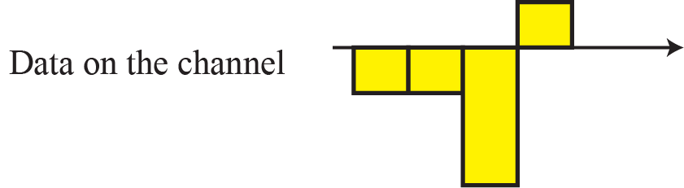
    Signal Representation in CDMA
Notes:
12.#

Slide 22
Summary
In this section we have discussed the following:
Multiple Access Protocols
Access control Protocols like TDMA, FDMA, CDMA and CSMA etc.
Notes:
1.#

Slide 23

Notes:
1.#

